Slide 1


Strategic Environmental and Social Assessment (SESA) of Green Hydrogen in the Central Valley
Working Group Meeting #1
09 June 2026
Dr Greg Schreiner
CSIR

Slide 2
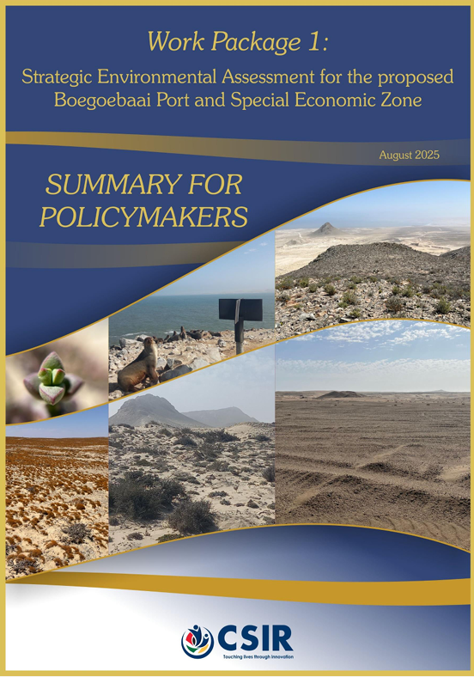
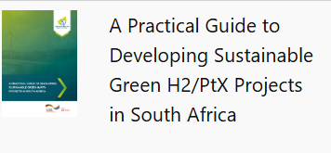
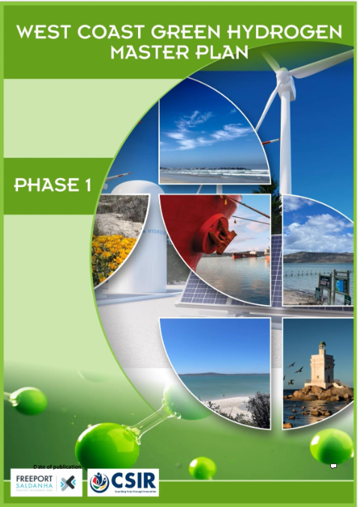
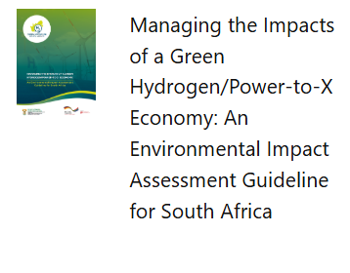
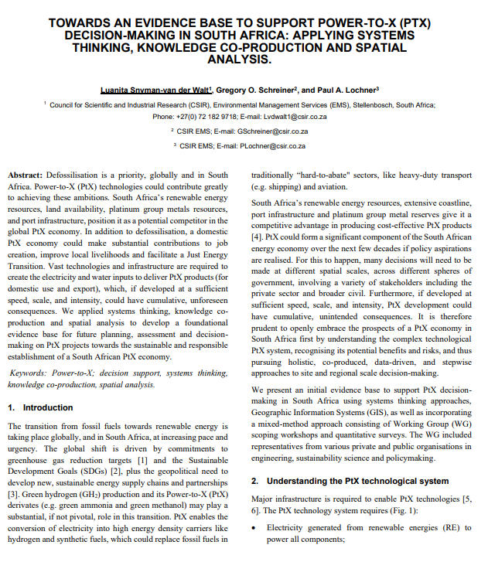
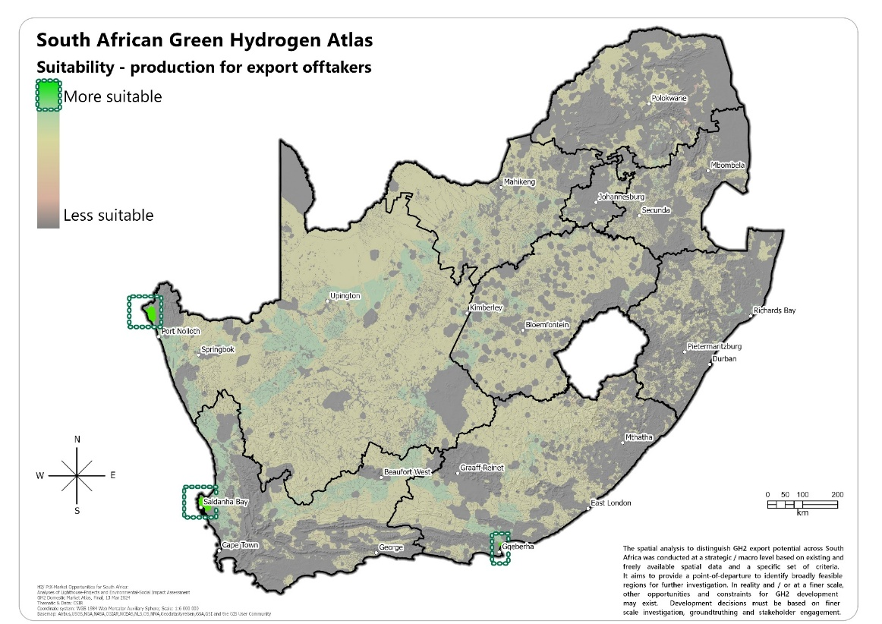
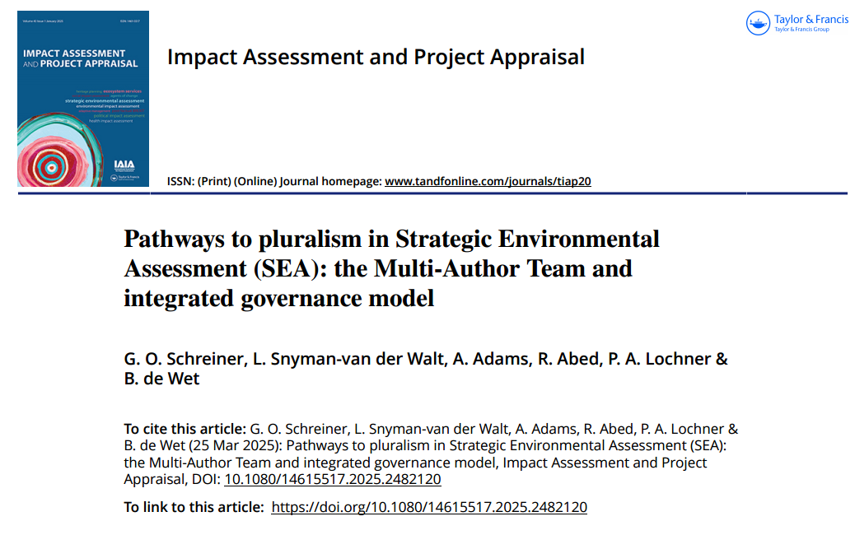
Our experience in SESA and GH2/PtX
30+ years SEA experience across Africa’s energy sector
50+ complex Strategic Environmental Assessments completed
GIZ, KfW, IFC, World Bank, National Government, Northern Cape, Eastern Cape, Western Cape, Freeport Saldanha etc…

Slide 3
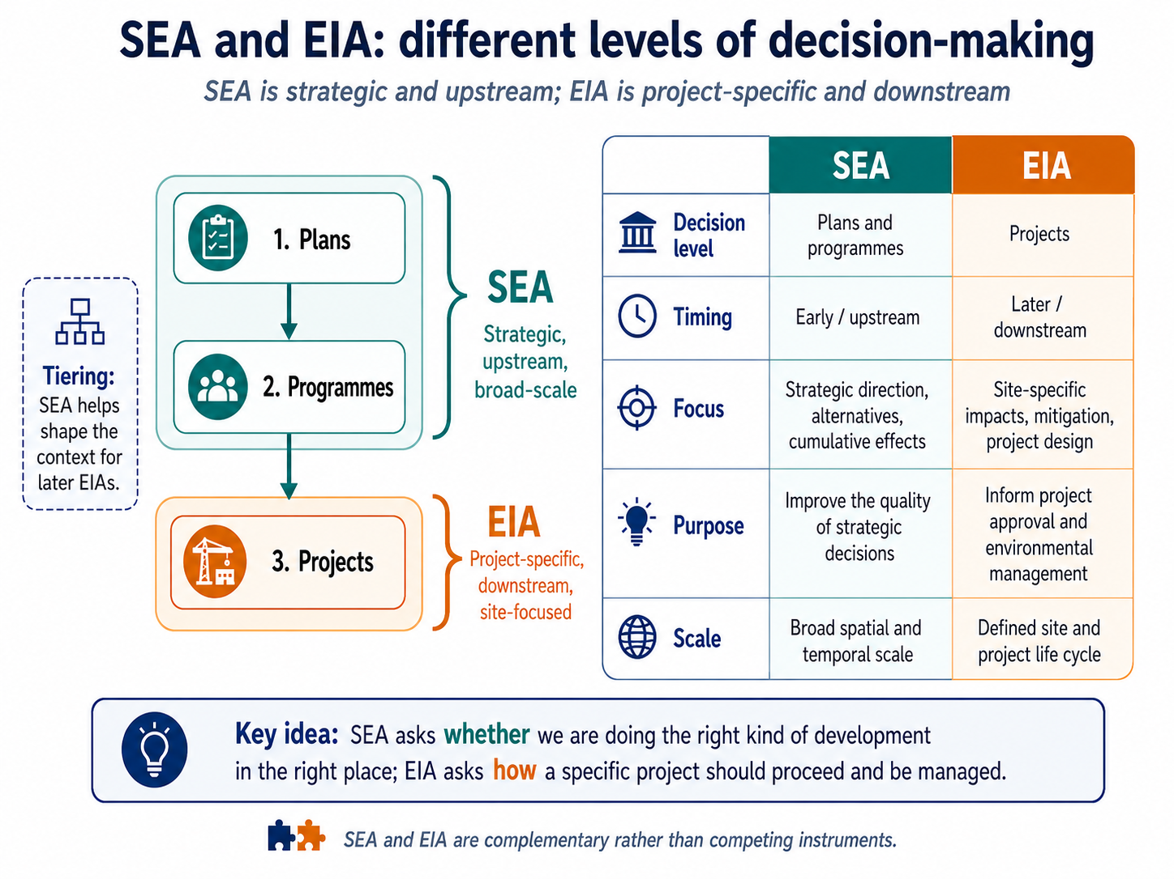

Slide 4
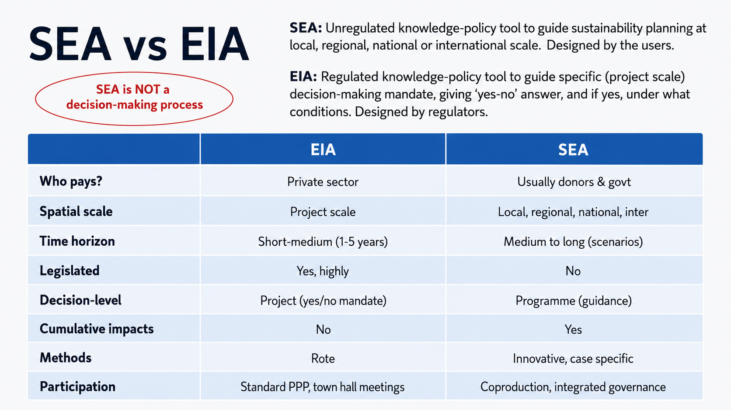

Slide 5
Where does SEA fit into decision-making/planning?
high
EIA
EIA
EIA
EIA
EIA
EIA
MANY, MANY decision-making processes over decades
EIA
IDP
EIA
EIA
EIA
Level of participation
NOT a decision-making process
EIA
EMF
EIA
EIA
EIA
SDF
EIA
Strategic Environmental Assessment (SEA)
EIA
EIA
Land negotiations
Concept stages/prefeasibility
Technical/feasibility/financial studies
low
2025
2030
2040
Time

Slide 6
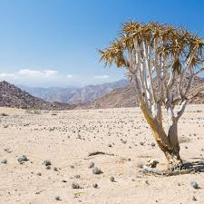
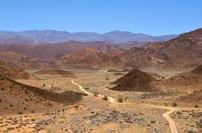


Need for a Central Valley SESA
Namibia’s Green Hydrogen and Derivatives Strategy (2022) targets a 10–12 Mtpa GH₂-equivalent economy by 2050, positioning GH₂ as a major future energy sector.
A large GH₂ industry could generate significant macro-economic benefits, including new jobs, skills, and value-chain opportunities domestically and globally.
Developing the sector requires major infrastructure, including renewable power (wind and solar), desalination plants, and extensive transport networks.
These developments will require large land areas and resource inputs, many located in sparsely populated but ecologically sensitive regions of Namibia.
Early impact avoidance, mitigation, and evidence-based planning are essential to ensure GH₂ development delivers benefits without undermining environmental sustainability.

Slide 7
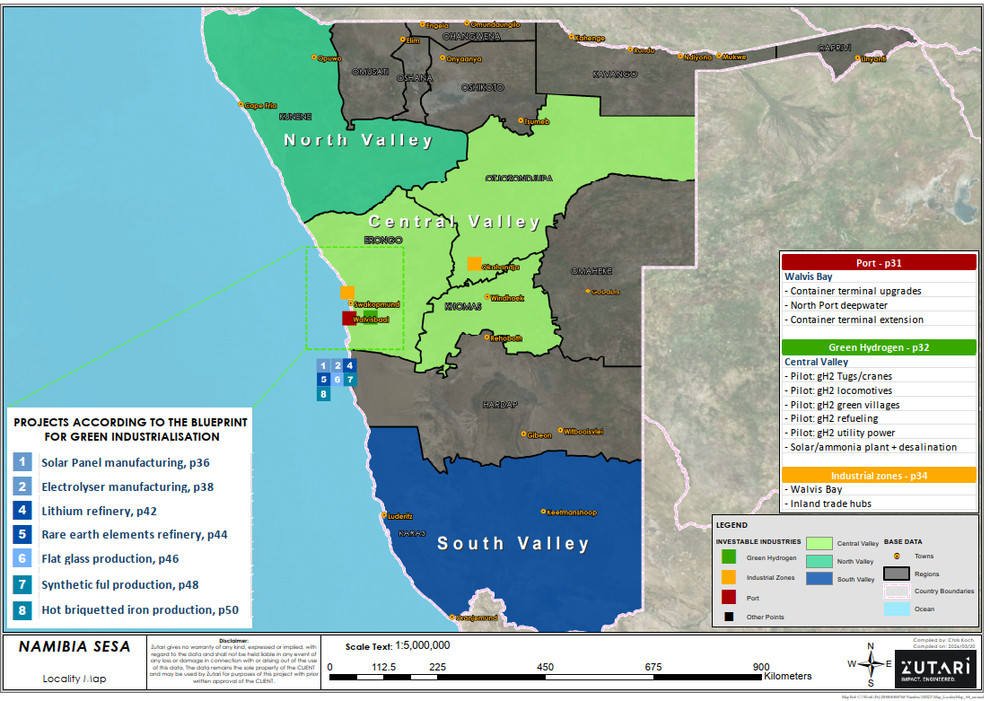
Map of the study area –
200 000 km² ~25% of Namibia
SESA study area

Slide 8
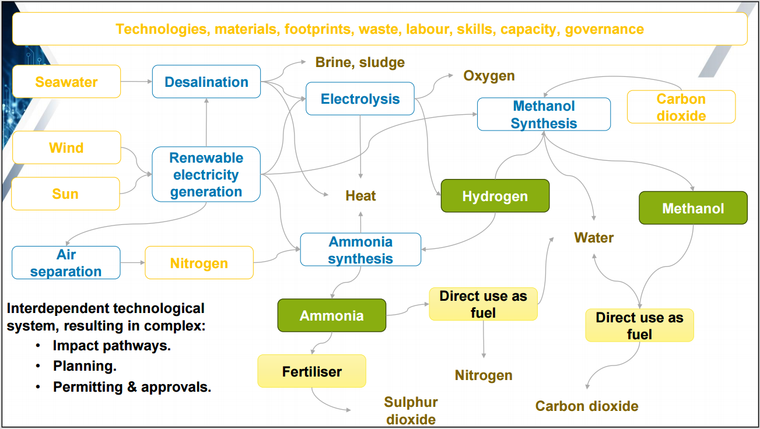
GH2/PtX -- A complex technological/infrastructure system
Schreiner & Snyman van der Walt et al (2024) Managing the Impacts of a Green Hydrogen/Power-to-X Economy: An Environmental Assessment Guideline for South Africa. CSIR: Stellenbosch. Report no: CSIR/SPLA/SECO/ IR/2024/0005/B

Slide 9
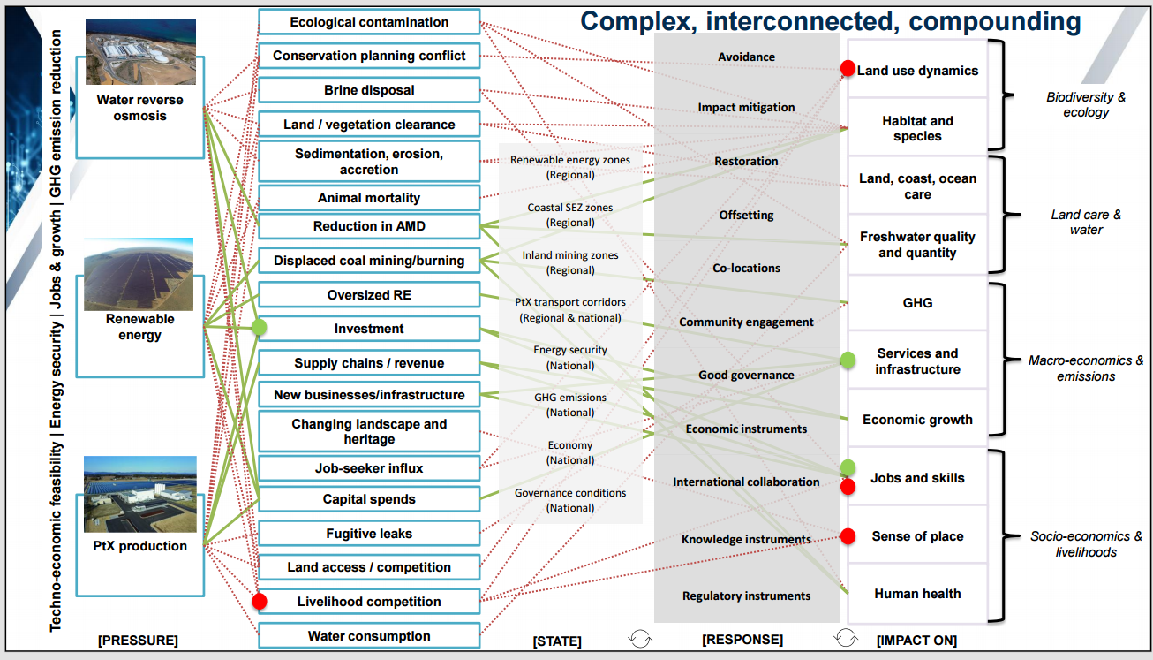
GH2/PtX -- A complex technological/infrastructure system
Schreiner & Snyman van der Walt et al (2024) Managing the Impacts of a Green Hydrogen/Power-to-X Economy: An Environmental Assessment Guideline for South Africa. CSIR: Stellenbosch. Report no: CSIR/SPLA/SECO/ IR/2024/0005/B

Slide 10
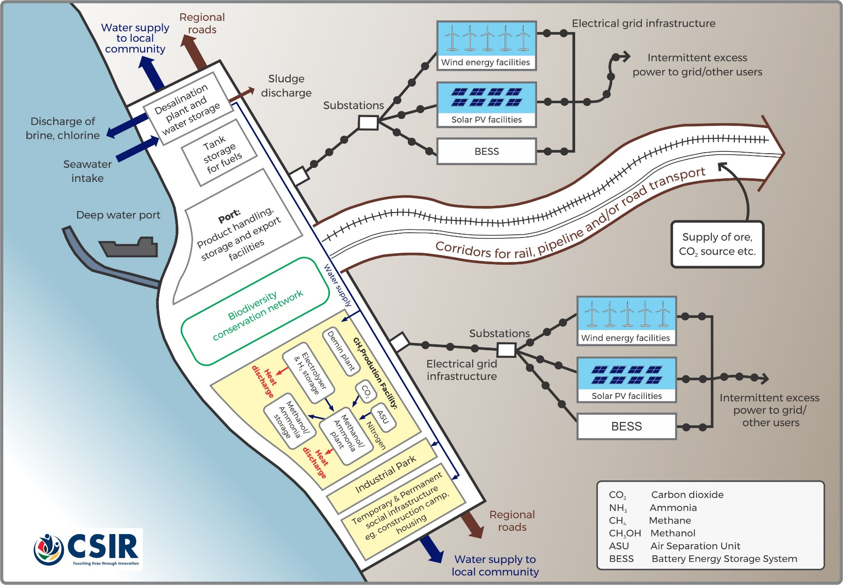
Scope of technology/infrastructure considered in the SESA

Slide 11
Study methods - scenarios
SMALL GH2 + EXISTING TRENDS
(2025 to 2050)
0.5 mtpa GH2-eq
MEDIUM GH2
(2030 to 2050)
1 mtpa GH2-eq
BIG GH2
(2040 to 2050)
3 mtpa GH2-eq

Slide 12
Study methods – scenario quantifications
Indicator | SMALL GH2 | MEDIUM GH2 | BIG GH2
GH2-eq production | 0.5 mtpa | 1 mtpa | 3 mtpa
Electrolysers | 5 GW | 10 GW | 30 GW
Renewable electricity demand | 30,000 GWh/y | 60,000 GWh/y | 180,000 GWh/y
Installed renewable capacity | 13 GW | 25 GW | 68 GW
RE mix: PV / onshore / offshore | 90 / 10 / 0% | 80 / 10 / 10% | 60 / 20 / 20%
Terrestrial planning envelope | 54,300 ha | 102,000 ha | 411,100 ha
Offshore wind envelope | – | 34,200 ha | 205,500 ha
Water demand | 35 ML/day | 70 ML/day | 215 ML/day
Desalination capacity incl. oversize | 30 ML/day | 70 ML/day | 235 ML/day
Brine discharge | 40 ML/day | 85 ML/day | 285 ML/day

Slide 13
Study methods – Sensitivity
Each chapter will classify spatial receiving environments across the study area into four-tier zones as follows:
VERY HIGH, HIGH, MODERATE, LOW.
The concept of Sensitivity refers to the degree to which a social or ecological attribute is likely to be affected—either positively or negatively—by external pressures, changes, or interventions.
In ecological contexts, this includes susceptibility to environmental changes, degradation, or disturbance. In social contexts, it encompasses how communities, livelihoods, or cultural values may be impacted by development, policy, or environmental change.
Sensitivity tier | Ecological attributes | Social attributes
Very High | Highly vulnerable to disturbance with little/no capacity for recovery. Includes endangered species, critical habitats, or ecosystems with narrow tolerances. Impacts likely irreversible or long-term. | Communities or groups are extremely dependent with limited adaptive capacity. Includes marginalized populations, cultural heritage sites, or subsistence livelihoods. Changes cause severe, lasting disruption.
High | Sensitive to change but with some recovery potential. Includes biodiversity hotspots or key ecosystem services with partial resilience. | Significant dependence with limited alternatives or buffers. Includes economically vulnerable groups or essential services. Changes can cause serious, though possibly recoverable, impacts.
Moderate | Some resilience to stress or change. Systems can absorb moderate impacts without long-term harm. Includes adaptable species or moderately sensitive habitats. | Moderate dependence and adaptive capacity. Disruptions may occur but are generally manageable or reversible.
Low | High resilience and low vulnerability. Includes widespread ecosystems or species with broad ecological niches and high regenerative capacity. | Low reliance and strong adaptive capacity. Impacts from changes are minimal and not likely to cause significant disruption.

Slide 14
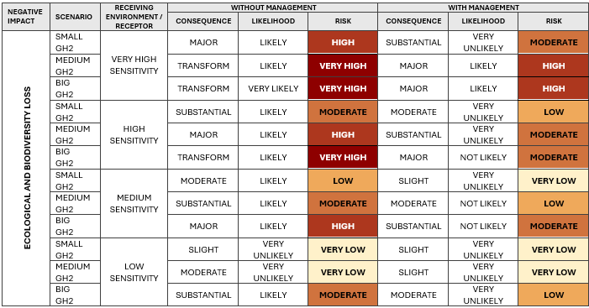
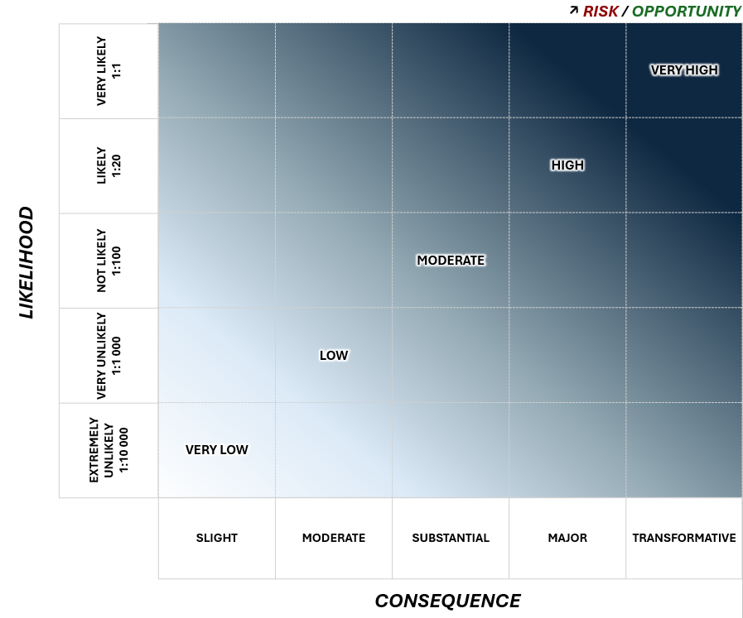
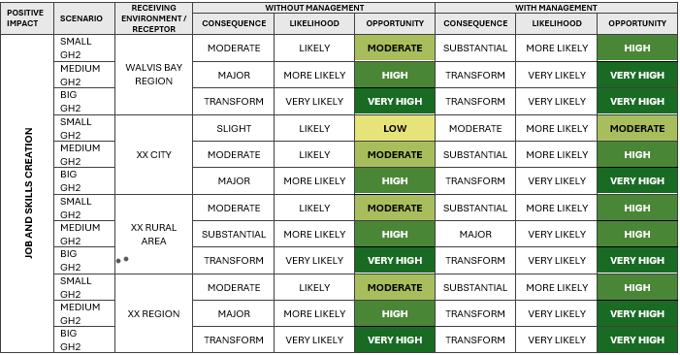
Study methods – Risk/Opportunity Assessment

Slide 15
Knowledge production process
SESA is grounded in coproduction principles, where processes and outputs are co-designed with users.
SESA will be developed through an iterative, collaborative process that brings together diverse expertise from government, private sector, NGO/CBOs, and research/academia to produce context-specific, policy-relevant knowledge.
Each chapter will be prepared by a small multidisciplinary team of credible regional experts, appointed as Integrating Authors or Contributing Authors, to ensure that both the process and outputs are shaped by relevant users and stakeholder perspectives.

Slide 16
Proposed SESA Chapters (draft)
The following initial SESA structure has been proposed:
0. Summary for Policymakers (SPM) (Peer reviewed) (~30 pg)
The purpose and process of the SESA (~10 pg)
The approach, methods and scope of the SESA (~30 pg)
Marine ecology, fisheries, mariculture and coastal livelihoods (<30 pg) (Peer reviewed)
Biodiversity and ecological impacts (flora, fauna, aquatic) (<30 pg) (Peer reviewed)
Impacts on social fabric, agriculture, tourism and other land uses (<30 pg) (Peer reviewed)
Macro and local economic impacts (GDP and jobs) (<30 pg) (Peer reviewed)
Heritage, sense of place and visual impacts to the landscape (<30 pg) (Peer reviewed)
Impacts on surface- and groundwater resources (<30 pg) (Peer reviewed)
Spatial and infrastructure planning (including common user potential) (<30 pg) (Peer reviewed)
Annex 1: Mitigation, Management and Monitoring Plan (MMMP)
Annex 2: Peer Review comments and responses (First Draft)
Annex 3: Stakeholder comments and responses (Second Draft)
Annex 4: Record of public outreach

Slide 17
Indicative chapter structure
Executive summary
Introduction and scope
Baseline receiving environment to 2050
Spatial classification of the receiving environment
Potential impacts
Risk/opportunity assessment
Mitigation, enhancement, management and monitoring measures
Conclusion and strategic recommendations
Positive impact | Mitigation | Management | Monitoring
Impact ….n | Describe best practice | Describe best practice | Describe best practice
Negative impact | Enhancement | Management | Monitoring
Impact…n | Describe best practice | Describe best practice | Describe best practice

Slide 18
Steering Committee
Mandated for overall SESA oversight
Experts
Team n…1
Team n…2
Team n…3
Working Group
Private sector, government, NGOs/
CBOs, Research
Management Committee
Clients & Project Team
Project Team
Zutari & CSIR
Constituency
n…1
n…2
n…3
Public briefings
Website/comment windows, briefing sessions

Slide 19
END

