Slide 1
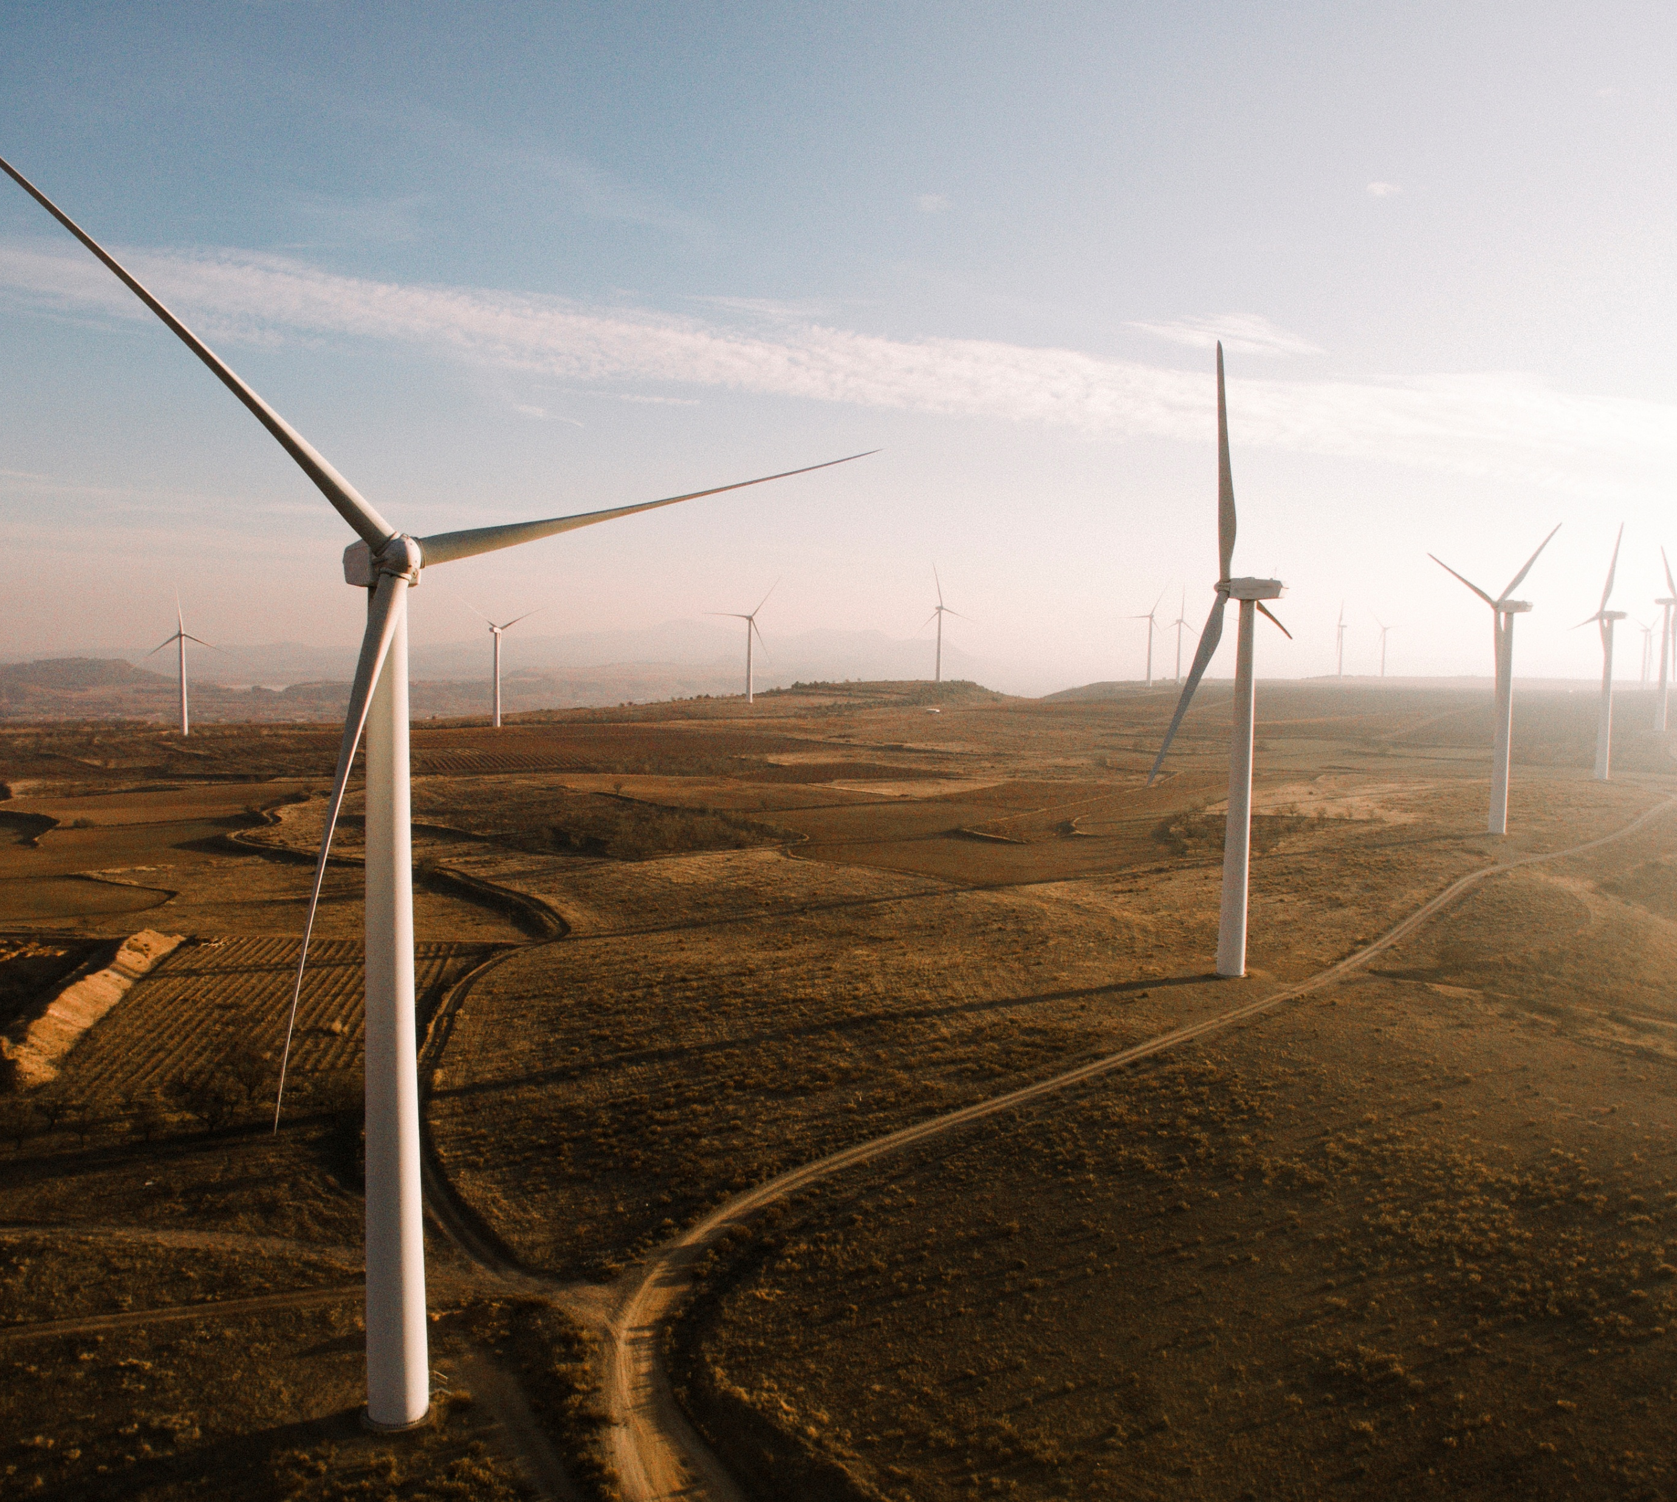

Central green hydrogen valley SESA
Stakeholder outreach approach

Slide 2

contents
1
Purpose and objectives of stakeholder outreach
2
Stakeholder outreach format
3
Roadshow route and locations
4
Key outreach considerations
5
Success factors
6
Inputs requested
All rights reserved | The purpose of this submission is to determine interest in and suitability for the client’s assignment. The information contained herein is confidential and proprietary to Zutari and/or its business partners. It may include personal information of data subjects connected to Zutari and/or our business purpose. To safeguard the information and the competitive position of bidders, this information shall not be used, disclosed or otherwise processed for any purpose other than the purpose for which it was developed. If Zutari is shortlisted or awarded a contract as a result of this information, the rights of use and processing shall be agreed and recorded in writing. If personal information needs to be processed it will be done in accordance with our Privacy Notice and the Protection of Personal Information Act, 4 of 2013. Anyone sharing provider of personal information of a data subject for inclusion herein warrants that the data subject has consented to processing of such information by Zutari. Any concerns may be addressed to the Zutari Information Officer.

Slide 3
Purpose and objectives of stakeholder outreach
Ensure the SESA process is visible, accessible and transparent.
Create opportunities for interested and affected parties to understand the project.
Gather local perspectives, concerns and contextual knowledge from across the study area.
Identify material environmental, social and livelihood issues early in the process.
Communicate the purpose, scope and process of the SESA in clear, accessible language.
Share information on the types of development and infrastructure being considered.
Reach stakeholders beyond formal institutional structures.
Support future review of the Zero Draft / scoping outputs and later draft reports.
Notes:
Key message Public outreach is intended to complement the technical assessment by bringing in place-based knowledge and stakeholder perspectives from across the corridor.

Slide 4
Stakeholder outreach format
First Roadshow
Undertaken when the Zero Draft is released.
Objective is to introduce the SESA and gather early input on key issues, concerns and priorities.
Second Roadshow
Undertaken when the Second Draft SESA is made available for broader review.
Objective is to share emerging findings and receive feedback on the draft assessment.
Engagement Format
Open-day style sessions.
Short presentation followed by discussion and Q&A.
Opportunity for public to raise concerns and identify missing issues.
Sessions designed to be understandable to non-technical audiences.

Slide 5
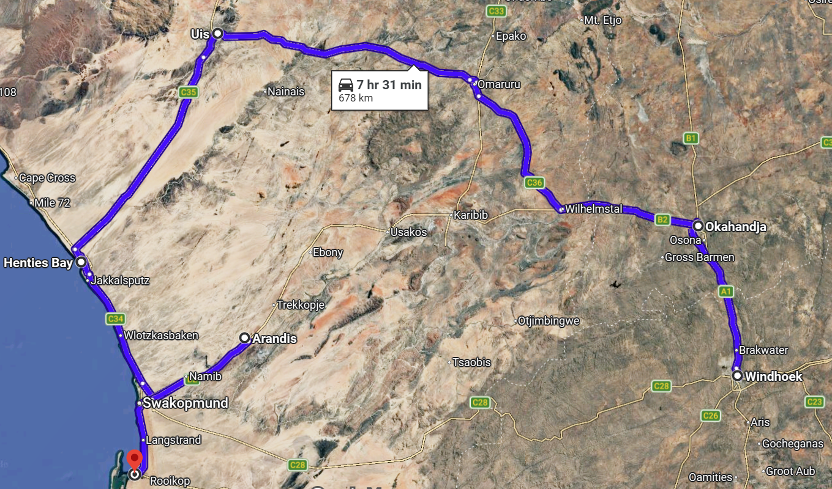
Roadshow route and locations
Notes:
The roadshow will begin in Windhoek from where the stakeholder engagement team
will travel along the A1 to Okahandja (76 km), and then to Uis via the B2 and C36 (259
km).
• The team will travel from Uis through the Tsiseb conservancy along the C35 to Henties
Bay (124 km) and along the C34 and B2 to Arandis (124 km).
• The team will then travel back along the B2 from Arandis to Swakopmund (60 km) and
on to Walvis Bay (29 km).

Slide 6
Key outreach considerations
Use multiple channels to advertise meetings (radio, newspapers, etc.)
Provide simple, consistent messaging
Clarify that the SESA is a strategic planning tool, not a project approval process.
Document issues carefully and explain how feedback will be considered.

Slide 7
Success factors
Reaches a broad cross-section of local and regional stakeholders.
Creates practical opportunities for participation.
Generates useful place-based input for the technical assessment.
Builds trust in the transparency and integrity of the SESA process.

Slide 8
inputs requested
Are the proposed locations appropriate?
Are there important towns or communities missing?
Any suggestions on the formats of local sessions?
Are there timing considerations or local factors to account for?
Comments on communication channels for meeting notifications.

Slide 9
The people, when rightly and fully trusted, will return the trust.
ABRAHAM LINCOLN

